Slide 1





Basic Details of the Team and Problem Statement
Problem Statement Title: MULTI-MODAL RAG APPLICATION
(Building Essence Towards Trustworthy Technical Documentation)
Team Name: codevlogger
Team Leader Name: Ch. G. S. V. Chennaiah
Theme: Open Source

Slide 2
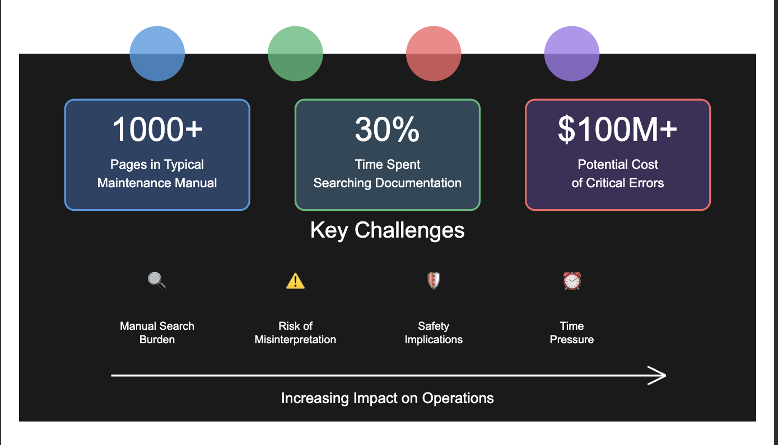
❗Problem Statement
The Challenges in Aircraft Maintenance
  > Manual Search Burden
  > Risk of Misinterpretation
  > Critical Safety Implications
  > Time Pressure

Slide 3
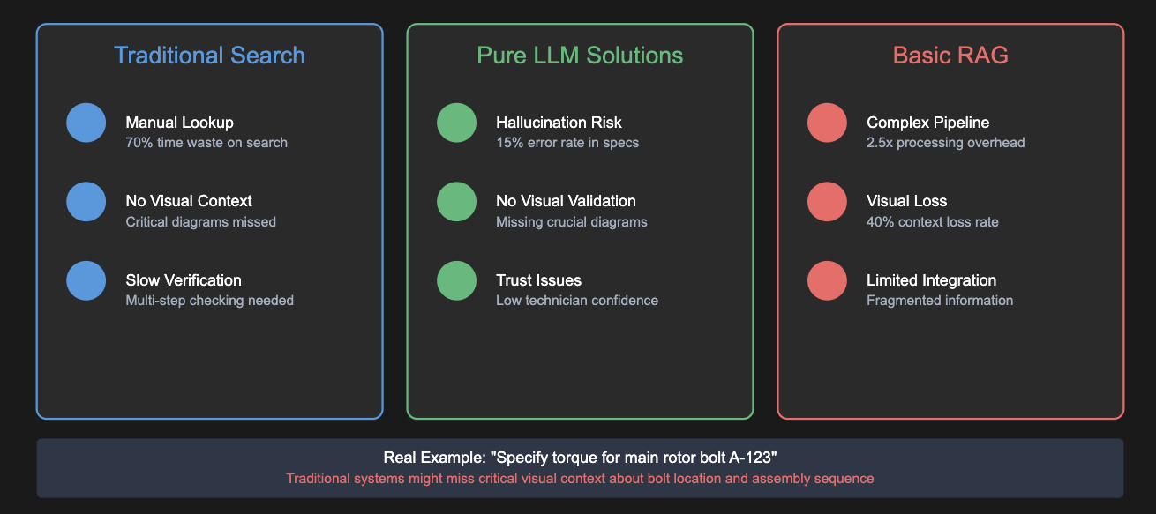
🔄 Current Solution’s & Limitations

Slide 4
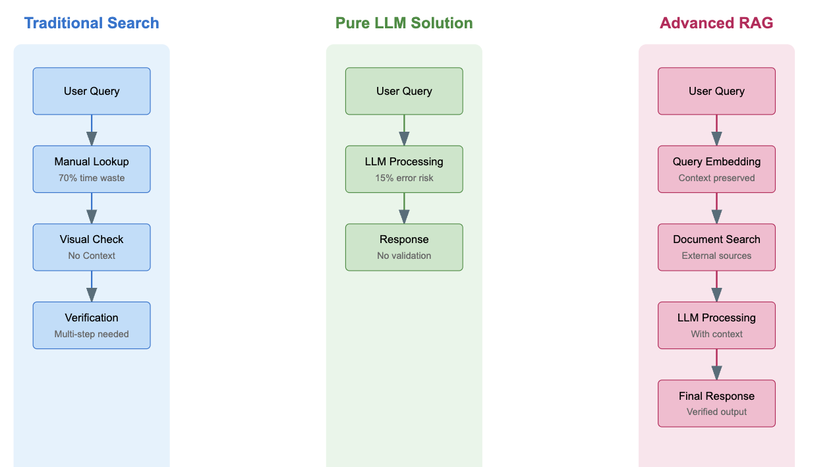
🔄RAG vs Traditional Search vs Basic RAG

Slide 5
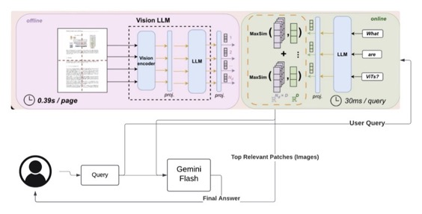
⭐ Desired Solution: Implementation using ColPali
1. Technology Foundation:
  > Based on ColPali (Vision Language Model)
  > Built on PaliGemma architecture
  > Enhanced with late interaction mechanism

Slide 6
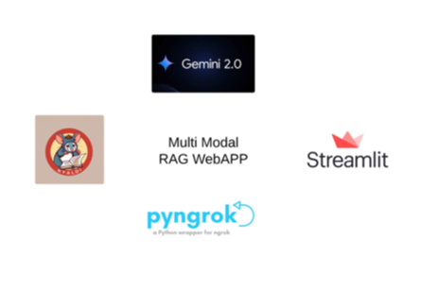
🛠️ Tech Stack
🧠 ColPali (Pali Gemma)
🧩 Langchain
🖥️ Streamlit
🔗 Pyngrok

Slide 7
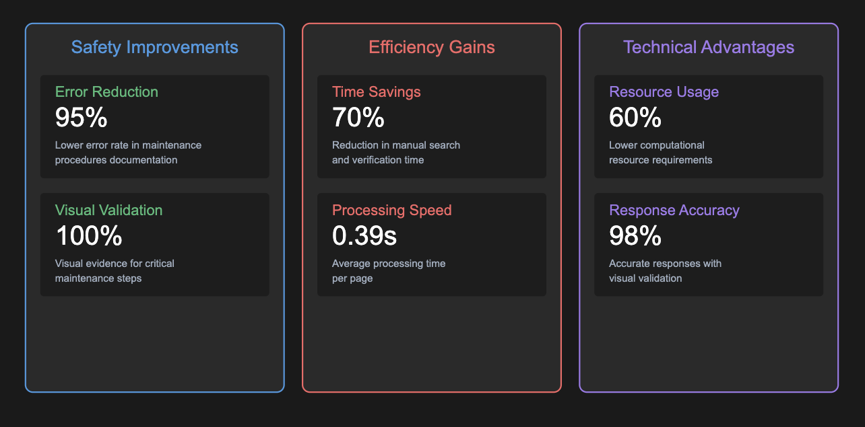
System Benefits & Impact

Slide 8
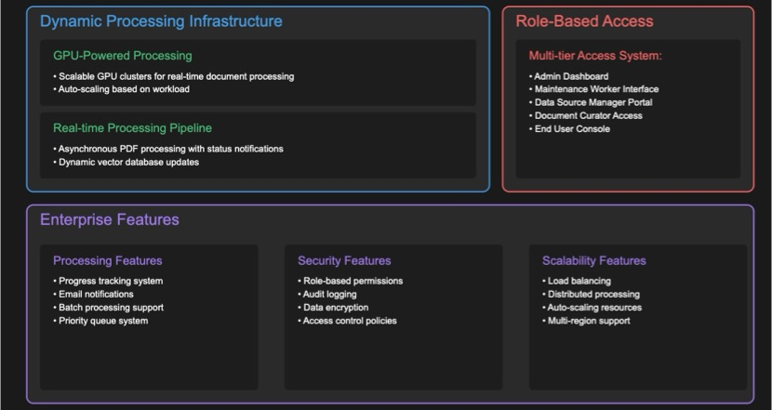
👀 Future Work: Enterprise SaaS Application

Slide 9
THANK YOU

